Slide 1




Nanocrystalline Soft Magnetics Workshop 2023
Introduction and AMPED Overview
August 17th, 2023
Prof. Paul R. Ohodnicki, Jr.,
Director, Advanced Magnetics for Power and Energy Development Consortium (AMPED)
RK Mellon Faculty Fellow in Energy
University of Pittsburgh
Prof. Subhashish Bhattacharya, AMPED Director (NCSU)
Prof. Brandon Grainger, AMPED Co-Director (Pitt)

Slide 2
Part I : Welcome and Introduction

Slide 3
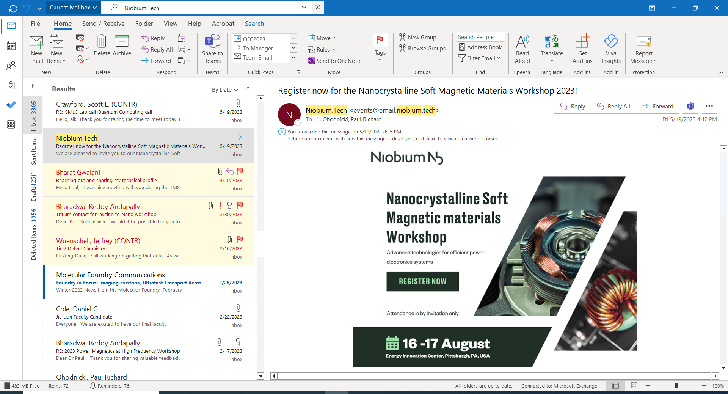
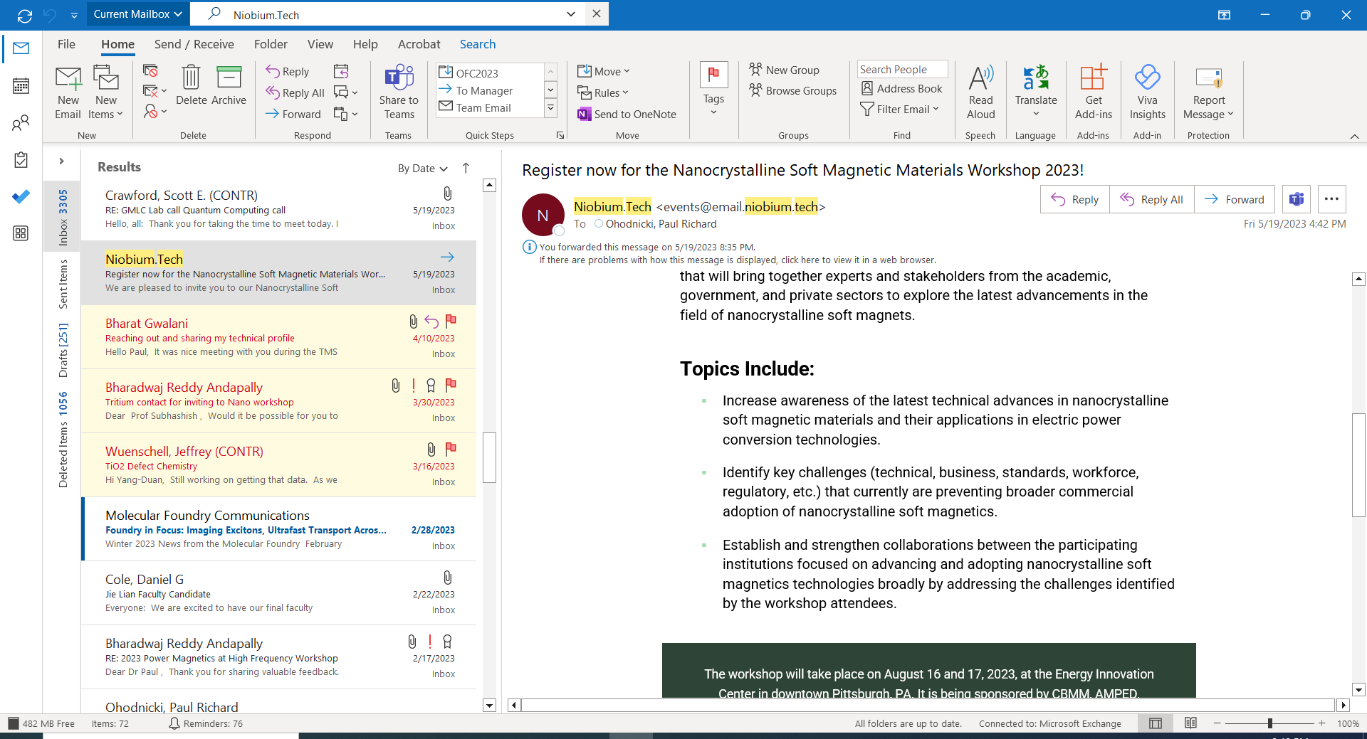
Welcome!
Organizers

Slide 4
Agenda (Morning)
8:00 – 9:00 AM : Registration and Networking
9:00 – 9:30 AM : Welcome and AMPED Introduction
9:15 – 9:45 AM : CBMM Overview on Nanocrystalline Magnetics (R. Bharadwaj, CBMM)
9:45 – 10:15 AM : Keynote (M. Ohta, Proterials)
10:15 – 10:30 AM : Break
10:45 – 11:45 AM : Nanocrystalline Soft Magnetics
Industrial Perspective - Panel
11:45 – 12:45 PM : Lunch

Slide 5
Agenda (Afternoon)
12:45 – 1:45 PM : Testing and Measurement Needs Including Standardization - Panel
1:30 – 2:30 PM : Presentations from Meeting Organizers
FREEDM, ASPIRE, Cambridge
2:30 – 3:00 PM : Networking and Break
3:00 – 4:00 PM : Nanocrystalline Soft Magnetics
Emerging Applications - Panel
4:00 – 5:00 PM : Nanocrystalline Soft Magnetics
Industry Next Steps
5:00 – 5:30 PM : Closing Remarks
5:30 – 6:30 PM : Social Hour and Poster Session

Slide 6
Part II: What is the AMPED Consortium?

Slide 7
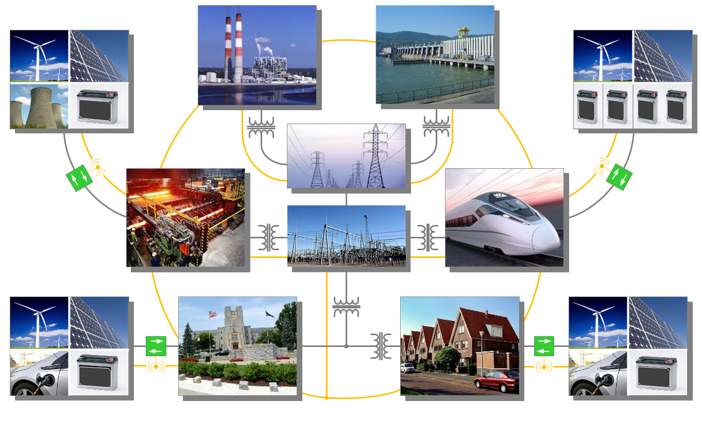
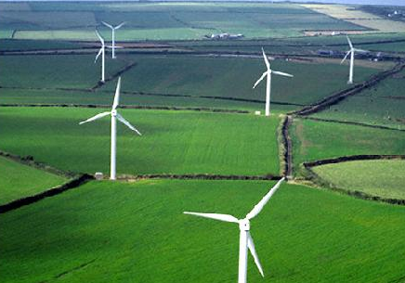
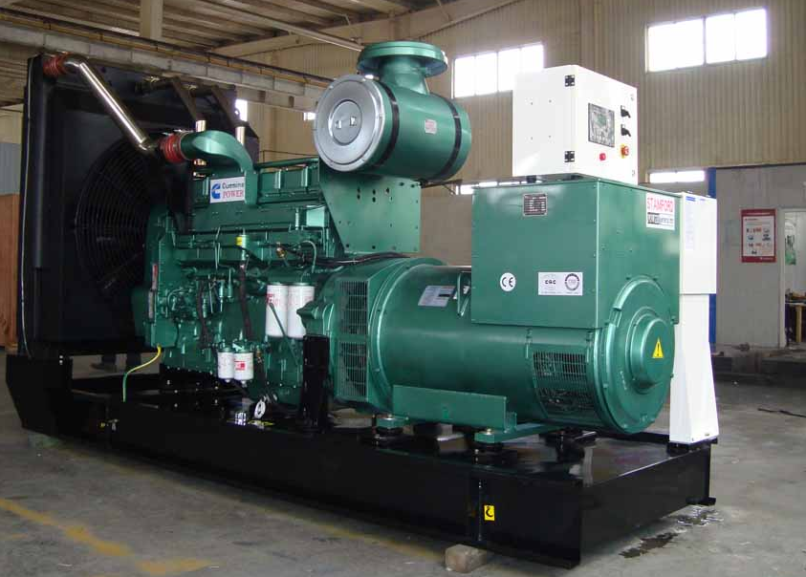
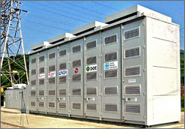
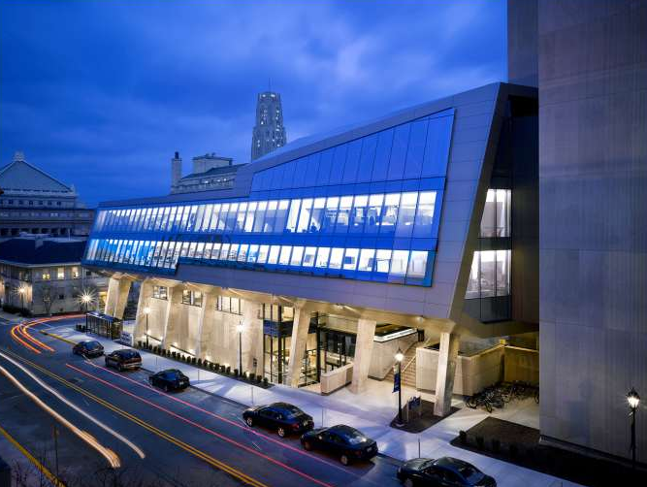
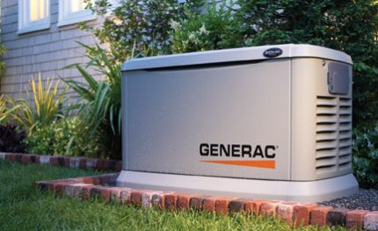

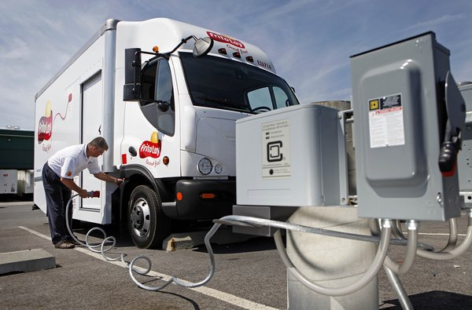
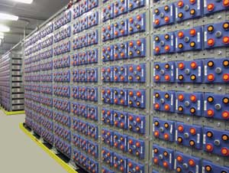
Motivation: Electrification in the 21st Century
DER, Storage, μ-Grid, DC
Power
Plants
Large-Scale
Renewables
(all types)
Power
Plants
Power
Plants
DER, Storage, μ-Grid, DC
Transmission
Communications,
Control, Security,
Power Conversion,
‘N’-Way Interface,
Automation, etc.
Transmission
Communications,
Control, Security,
Power Conversion,
‘N’-Way Interface,
Automation, etc.
Distribution
Distribution
Industry
Industry
Transportation
Transportation
Residential
Commercial
Residential
Commercial
DER, EV, Storage, μ-Grid, DC
DER, EV, Storage, DC
Challenge: A Need Exists for a Next Generation, Interdisciplinary Workforce and Targeted Research Support of Magnetic Devices (Transformers, Inductors and Electric Vehicle Motors)

Slide 8
Advanced Magnetics for Power and Energy Development (AMPED)
Mission Statement
To develop an innovation ecosystem and educational programs for advancing soft magnetic materials and component technologies spanning fundamental science to end-use application in collaboration with various agencies, offices, and programs.
Example:
Pitt Programs
Overall Vision / Prioritization…

Slide 9
Advanced Magnetics for Power and Energy Development (AMPED)
Mission Statement
To develop an innovation ecosystem and educational programs for advancing soft magnetic materials and component technologies spanning fundamental science to end-use application in collaboration with various agencies, offices, and programs.
Example:
Pitt Programs
Formalized Participation
A Formal Participation Option is Available for Partners

Slide 10
Near-Term Structure and Execution of AMPED
Formalized Participation
Resources for Student Support (AMPED Fellowships, Funding, Equipment Donations)
University of Pittsburgh
Industry / Lab Members
Establish and Maintains Memberships
Distribute Funds to University Partners
Administrative Support and Coordination
Develop Communication and Promotional Materials
AMPED
Coordinated Student Education and Research Activities
University of Pittsburgh
Local Foundations
North Carolina State University
Other Sources?
Integrated Research Effort with a Single Point of Entry

Slide 11
How Can You Get Involved?
For Information About Joining Contact: amped@pitt.edu
(David Ruvolo, Administrative POC, david.ruvolo@pitt.edu)

Slide 12



















Charitable Contributors
Full Participants
AMPED Consortium Industry Participants

Slide 13
Core Capability Focus Areas Across Universities Directly Aligned with Industry Needs
Magnetic Materials and Manufacturing
Component Design and Optimization
Magnetics Characterization & Standards
(Including at MV)
Power Electronics Converters and Controls
Electric Motors Design and Controls

Slide 14
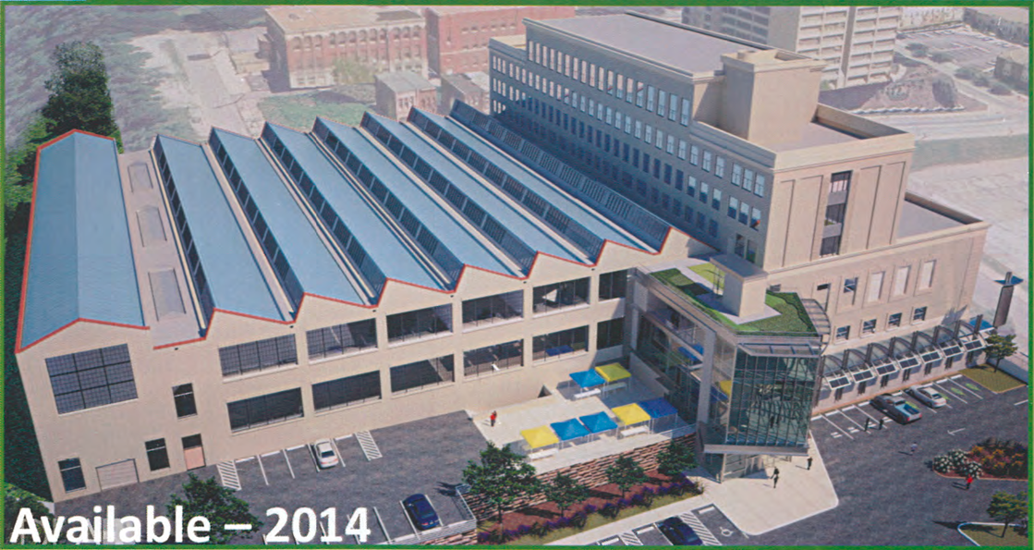
Shared R&D Labs for the AMPED Consortium
Downtown Pittsburgh Laboratory Facilities
New Magnetics Lab to Support the AMPED Consortium
Core Prototyping, Manufacturing, and Thermal Processing
Core Loss Testing (LV and MV)
Facilities Established for Education, Research, and Fee for Service

Slide 15

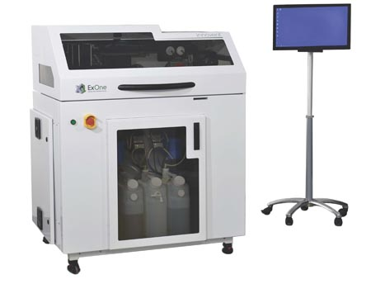
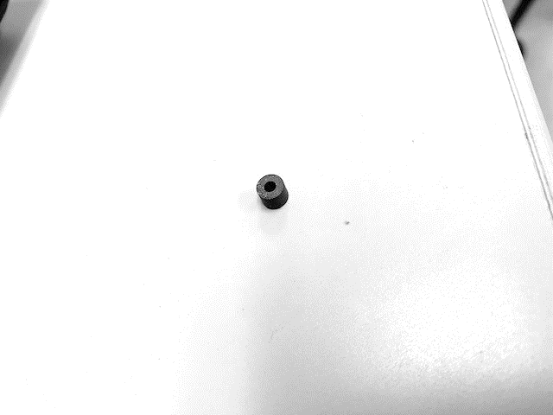
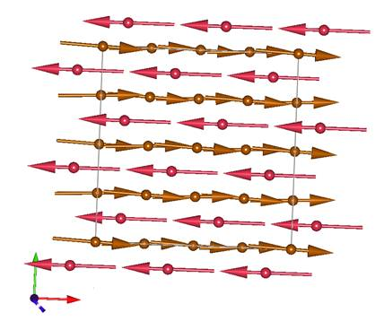

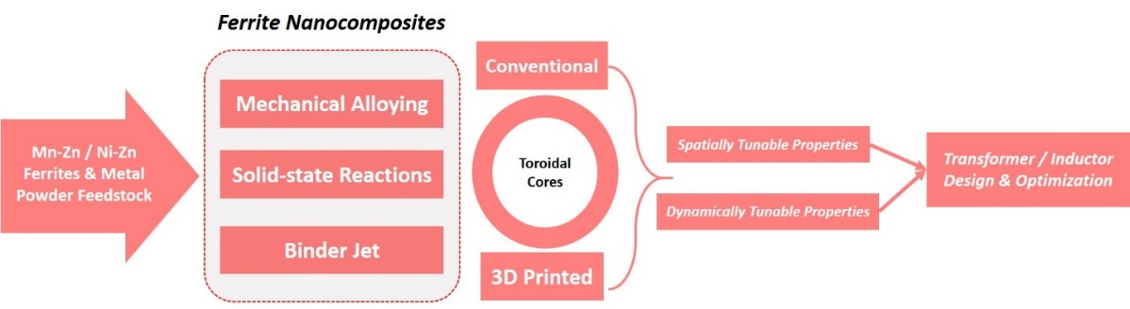
Current Status : Federal R&D Collaborations
Basic Research : Grant
Ravisekhar Raju
University of Pittsburgh – FastWatt, LLC
Exploring New Materials and Manufacturing Techniques for Ferrites
Inductor and Transformer Design Methods and Applications of Ferrites

Slide 16
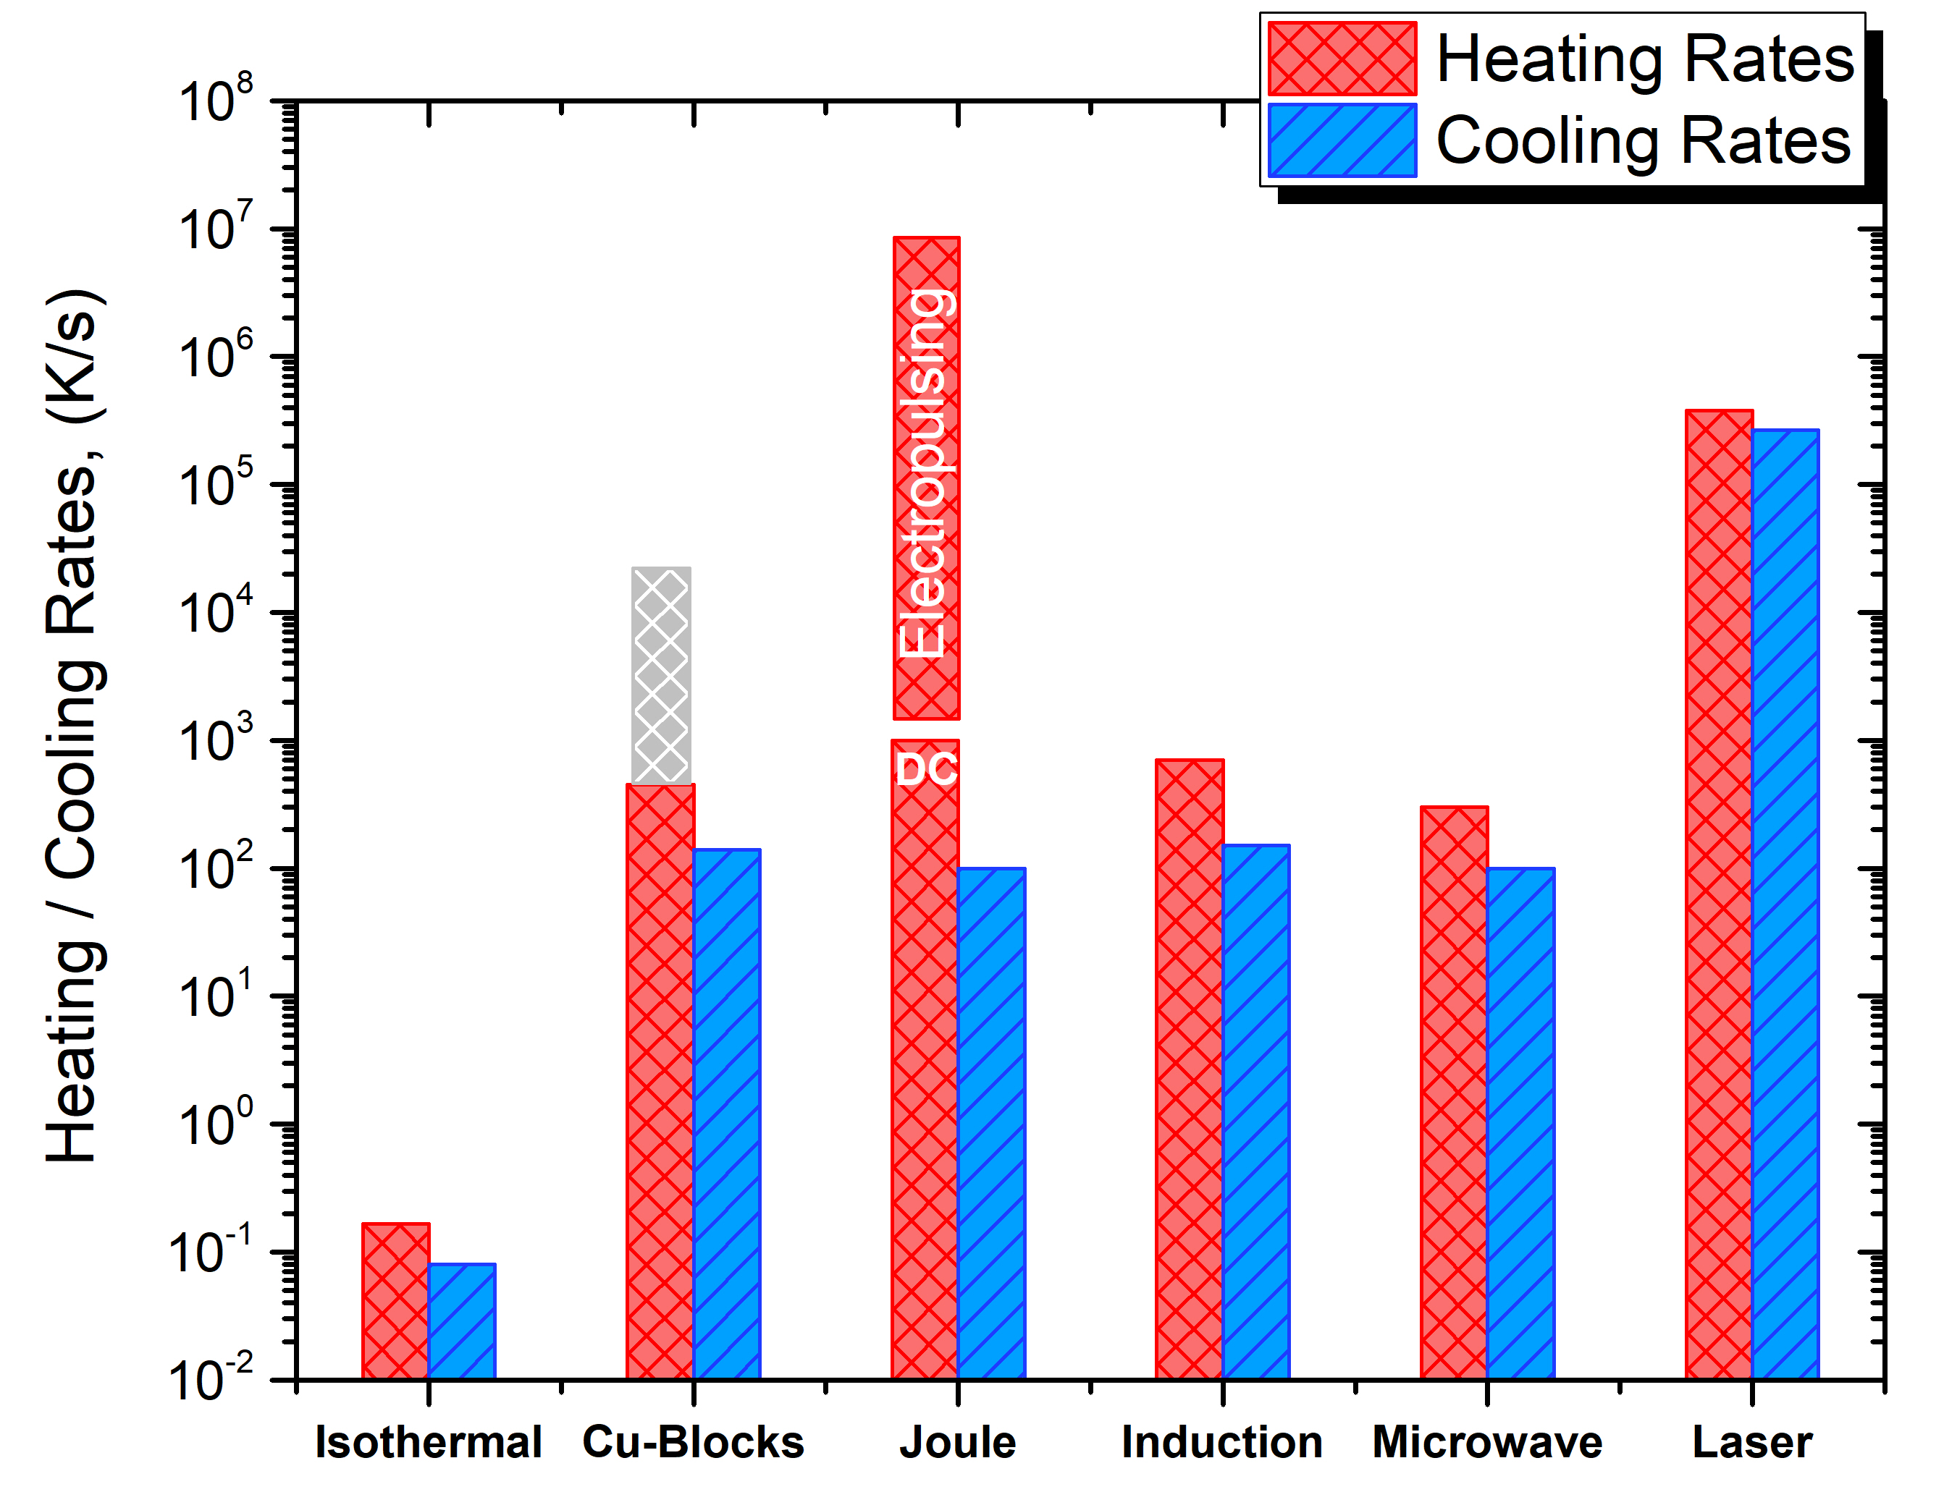


Current Status : Federal R&D Collaborations
DOE Laboratory Subcontract
Jagannath Devkota
Univ. of Pittsburgh – North Carolina State Univ. – NETL
Developing New Reel-to-Reel Manufacturing Processes of Amorphous Alloys
Characterization of Magnetic Cores and Components for Applications

Slide 17

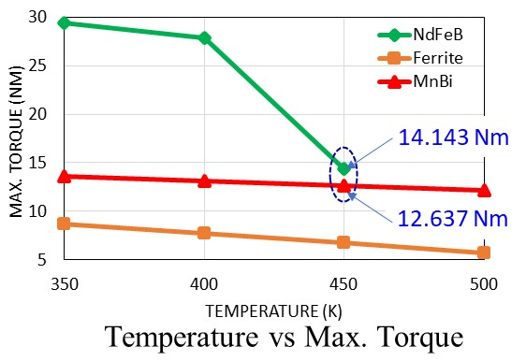
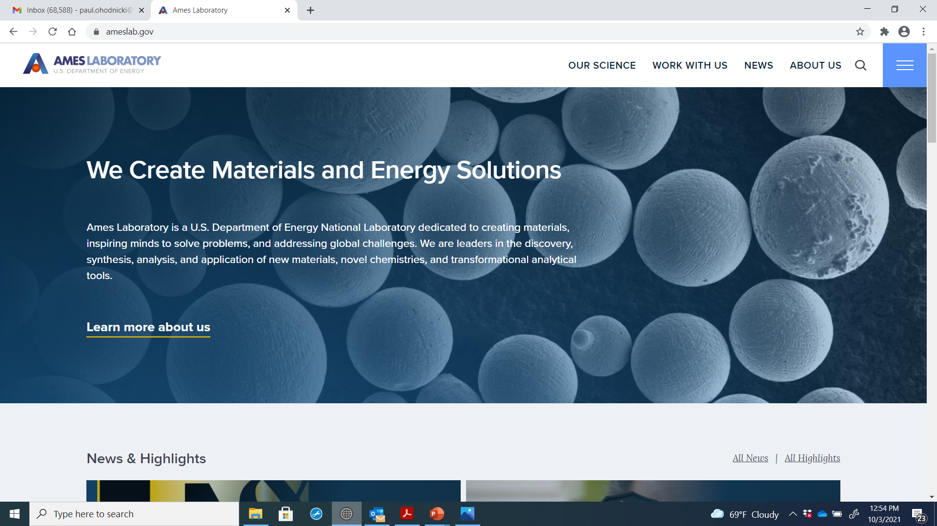
Current Status : Federal R&D Collaborations
Phase I & II : STTR Program
Andrew Sherman
Nicholas Krywopusk
Benjamin Pratt
Jun Cui
Powdermet – Ames Laboratory – University of Pittsburgh
Seeking Commercialization of Ames Lab Developed REE Permanent Magnets
University of Pittsburgh / AMPED Role : Design of REE-Free PM Motors

Slide 18
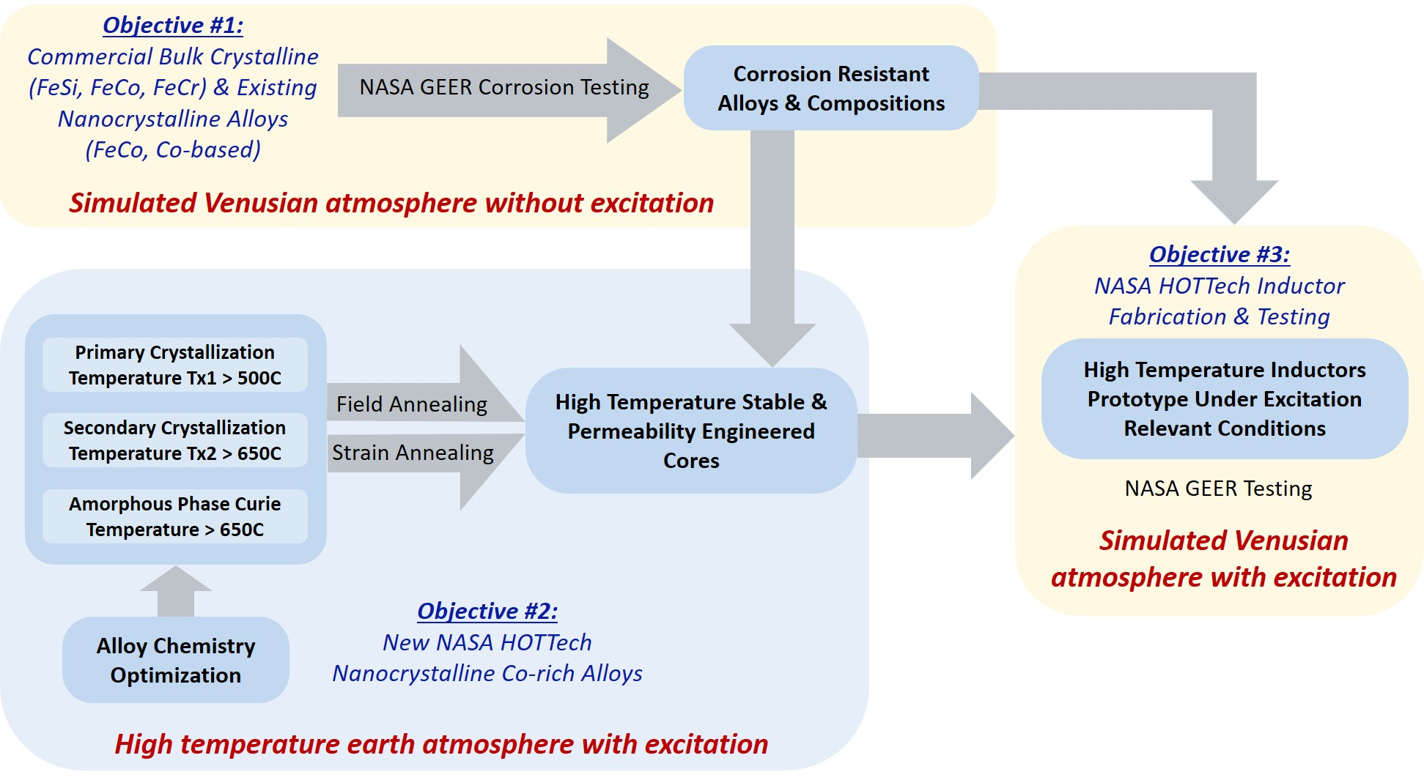



Current Status : Federal R&D Collaborations
Basic Research : Grant
NASA HOTTech Program
Alex Leary
Ronald Noebe
Lei Xing
Kevin Byerly
Sam Kernion
NASA – Raytheon – CorePower – Univ. of Pittsburgh
Extreme Temperature and Extreme Environment Soft Magnetics
Target Demonstrating Inductor Material and Technology at T=500C

Slide 19
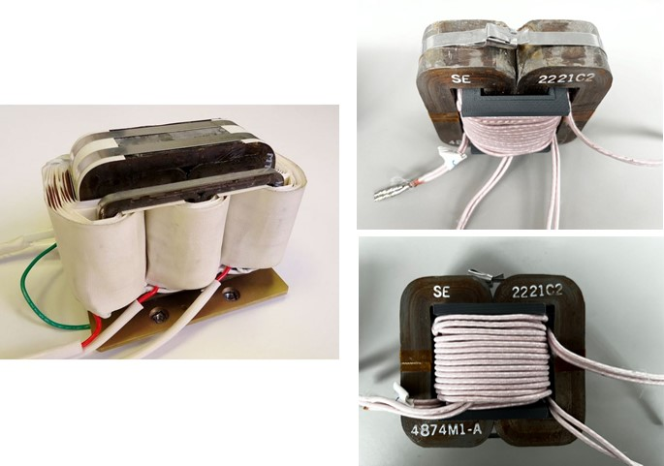

Current Status : Federal Design Collaborations
Magnetic Component Design
Sean Dowhy
University of Pittsburgh – BPMI
Advanced Magnetic Component Designs for Naval Applications
Benchmarking of Existing Technologies and Engaging with Various Vendors

Slide 20


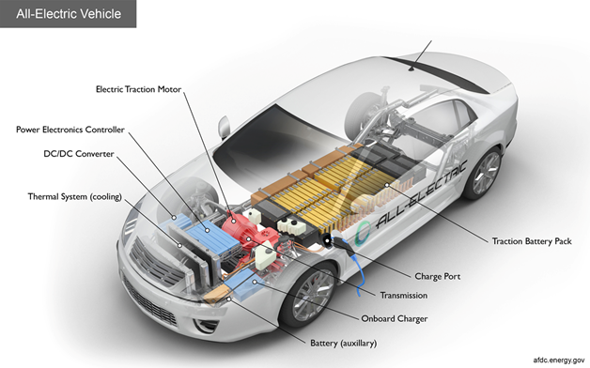
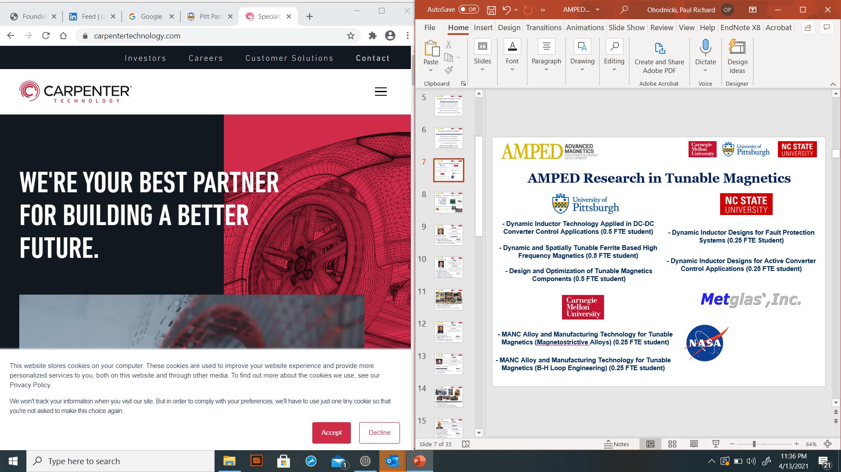
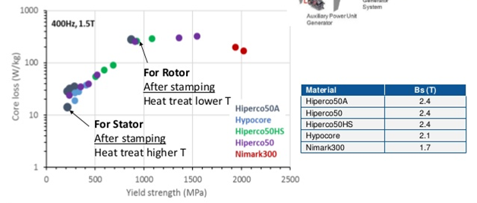
Current Status : State R&D Collaborations
Technology Transfer Program
Natan Aronhime
University of Pittsburgh – Carnegie Mellon - Carpenter
Exploring New Processing Methods and Techniques for Hiperco Laminations
Intellectual Property Filed at University of Pittsburgh Being Explored

Slide 21






Current Status : Foundation Donations
AMPED Program Support
Workforce Development and Seed Funding for National Growth
University of Pittsburgh – Hillman Foundation
New Materials and Manufacturing Research of Ferrites and Nanocomposites
Power Electronics and Motor Technology Design, Development and Testing

Slide 22
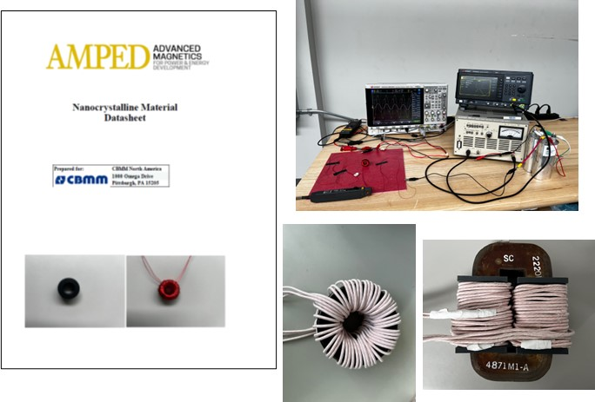

Current Status : Industrial Collaborations
Data Sheet Development
Bharadwaj Reddy Andapally
Mariana Perez de Olivera
University of Pittsburgh – CBMM
Standardized Testing of Materials and Electromagnetic Components
Benchmarking of Nanocrystalline Soft Magnetic Cores vs. Industry Standard

Slide 23
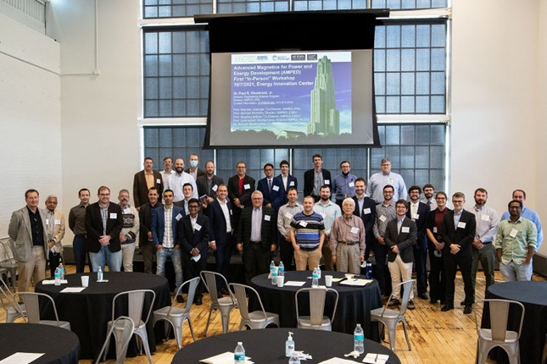
Consider Becoming a Part of Our Community!
Email : AMPED@pitt.edu
http://engineering.pitt.edu/AMPED
Our Priority is Focused on Workforce Development, Collaborate with Us to Support Your Needs in Talent Development!

